Slide 1

CMR COLLEGE OF ENGINEERING & TECHNOLOGY
Kandlakoya, Medchal, Hyderabad - 501401
Department of Computer Science and Engineering
MAKING LINKED LISTS EASY
PRESENTED BY:
B.GANESH - 20H51A05B1
B.SHRAVYA - 20H51A05B5
K.SAI HARSHA -20H51A05C7
Under esteemed guidance of :
Major Dr. V.A.NARAYANA

Slide 2
Outline
Abstract
Introduction
Literature survey
Existed system
- Problems in existed system
Research Objective of Presentation
Problem Definition
Research work
- Proposed system architecture
- Methods
- Comparison of Proposed system with an existed system
Performance Measure
Results
Conclusion
Future Work
Notes:
2

Slide 3
Abstract
Notes:
3

Slide 4
ABSTRACT
The idea of our project is to increase the reusability and ease of insertion, deletion etc in a Linked List. There isn’t an existing solution that addresses the issue of increasing the reusability of code. In our project we will be including the following functions that can help in performing specific operations on linked lists.
Insert
Delete
Detect cycles and remove cycles
Check whether two linked lists are connected or not
Reversing
Sorting
Checking a key in a linked list
Operations on linked lists are done by calling the functions enclosed in a Custom Header file which we created to increase the reusability of code.

Slide 5
INTRODUCTION
Notes:
5

Slide 6
Introduction
Linked list is a widely used data structure which is mainly used in Image Viewer, Previous and next page in a web browser, music player etc.
There are majorly two types of Linked Lists :
Singly Linked Lists
Doubly Linked Lists
Linked Lists are used in many competitive programming problems and some web applications etc. In such cases we cannot repeated write the same code to perform necessary operations on the linked lists.
Hence, in order to overcome this issue we came up with an idea to include some frequently used operations in the form of functions inside a header file.
Notes:
6

Slide 7
Literature Survey
Notes:
7

Slide 8
Existing system
There are no fully working or well efficient existing solutions for the problem statement which we have chosen. But, one of the Existing Systems is given below :-
Using Functions :-
We generally use functions to increase the reusability of our code and to decrease the effort. So hence we can make use of functions concept to perform operations on Singly Linked Lists such as Insertion, deletion etc.
Disadvantages of Existing System :-
There is no Header File which can be used to perform basic operations on the Singly Linked Lists. Functions can be used at a local scope/global scope. But, the functions in one file cannot be accessed in a different C/C++ File.
Notes:
8

Slide 9
Research Objective
Notes:
9

Slide 10
Research objective
Our Research Objective is to find out a way to increase the reusability of code by using functions to perform operations on Linked Lists. We came to know that such functions are not present in the C/C++ Library by default. Hence we tried to find existing systems and tried to find out an efficient solution to solve this issue.
To achieve this we have gone through online forums and other sources to find out a solution that increases the reusability of the code and therefore decrease the code redundancy. This can be helpful to the applications that use linked lists in the domain they are working in.
We found some solutions and came up with an idea to incorporate the concept of User Defined Header Files in solving this issue.

Slide 11
Problem Definition
Notes:
11

Slide 12
Problem Definition
There are many cases where we use Linked Lists and by linked lists we mean Singly Linked Lists here. And there are many situations in which we need to perform operations on the linked lists such as Insertion, Deletion, Reversing, Sorting etc.
In order to perform such operations on the linked lists. But in real world scenario we might need to use the operations quite often, which means that the code ,must be written according to our needs and this leads to unnecessary redundancy of the same code.
Hence to overcome this problem we’re incorporating the concept of the Header Files using which we can reuse the code just by including the header file and we can access the functions defined in it.

Slide 13
Research Work
Notes:
13

Slide 14
Proposed System Architecture
Insert Header File
Create List in .cpp file
Use the functions
Insert at begin / location / last
Delete at begin / location / last
size
cycle
connected
display
key
sort
Performs the desired function
Output

Slide 15
Proposed Methods
void beginInsert(type data);
void lastInsert(type data);
void locInsert(type data, int loc);
void beginDelete();
void lastDelete();
void locDelete(int loc);
void makeCycle(int pos);
bool isCycle();
void removeCycle();
void reverse();
bool isKey(type key);
bool isSorted();
void intersect(dsa::Node<type> head1, int pos);
bool isConnected(dsa::Node<type> head1);
void sort();

Slide 16
Performance Measure:
Functions | Best Case | Average Case | Worst Case
beginInsert | O ( 1 ) | O ( 1 ) | O ( 1 )
lastInsert | O ( 1 ) | O ( n ) | O ( n )
locInsert | O ( 1 ) | O ( n ) | O ( n )
beginDelete | O ( 1 ) | O ( 1 ) | O ( 1 )
lastDelete | O ( 1 ) | O ( n ) | O ( n )
locDelete | O ( 1 ) | O ( n ) | O ( n )
display | O ( 1 ) | O ( n ) | O ( n )
IsCycle | O ( 1 ) | O ( n ) | O ( n )
removeCycle | O ( 1 ) | O ( n ) | O ( n )
Size | O ( 1 ) | O ( 1 ) | O ( 1 )
isKey | O ( 1 ) | O ( n ) | O ( n )
isSorted | O ( 1 ) | O ( n ) | O ( n )
isConnected | O ( 1 ) | O ( n ) | O ( n )
sort | O ( 1 ) | O ( n ) | O ( n )

Slide 17
Result Analysis
Our project has reached the goals which we expected it to reach, it decreased the redundancy of code by using the concepts of functions. But, as we know the function’s scope is only local to that particular C/C++ file. So, we combined the concept of User defined Header files along with the concept if functions to reach the desired result.
The project has reached its goal of increasing the reusability of code to perform some most frequently performed operations on the Singly Linked Lists.
We have written the functions in a User Defined Header File. The functions we wrote inside the header file are optimal and efficient. We used the concept of OOPS by making use of Classes and Objects.

Slide 18
Screenshots of Execution

Slide 19
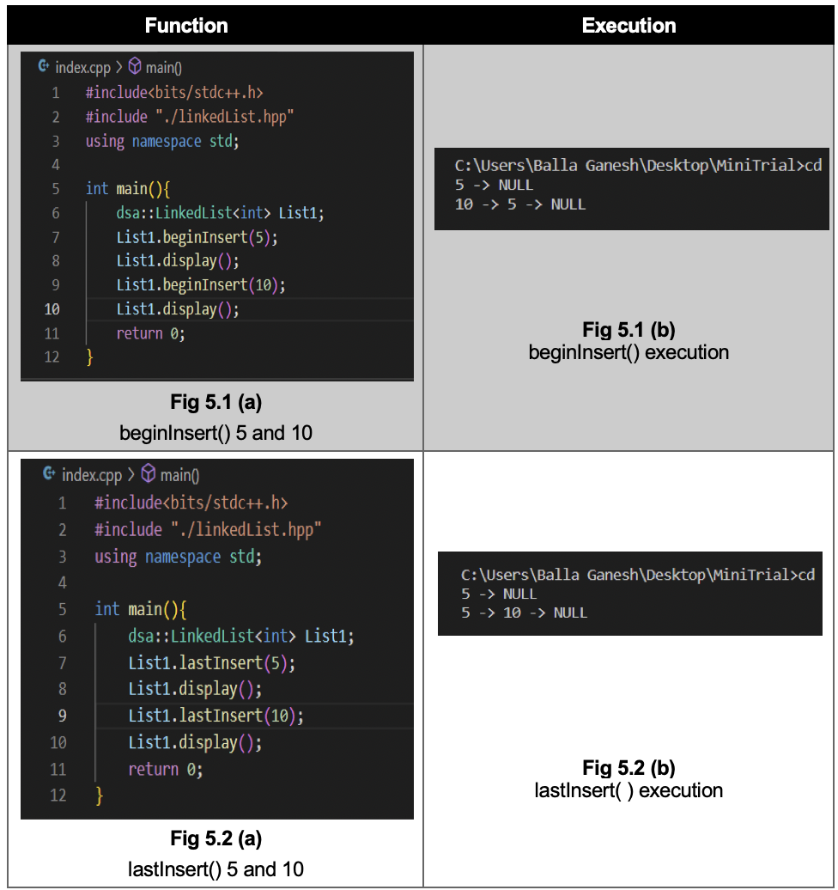

Slide 20
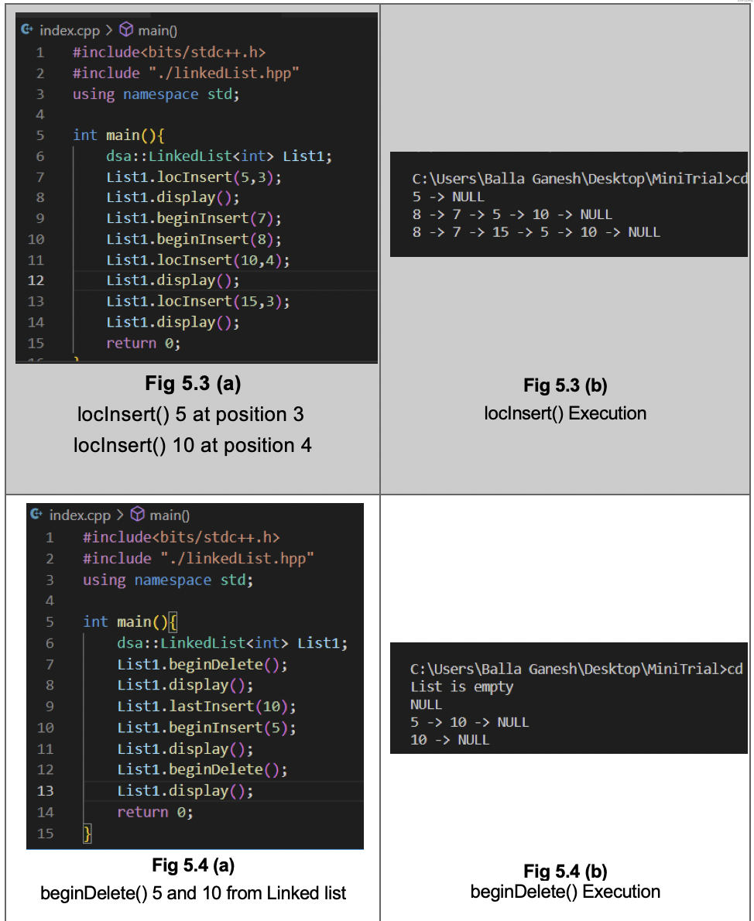

Slide 21
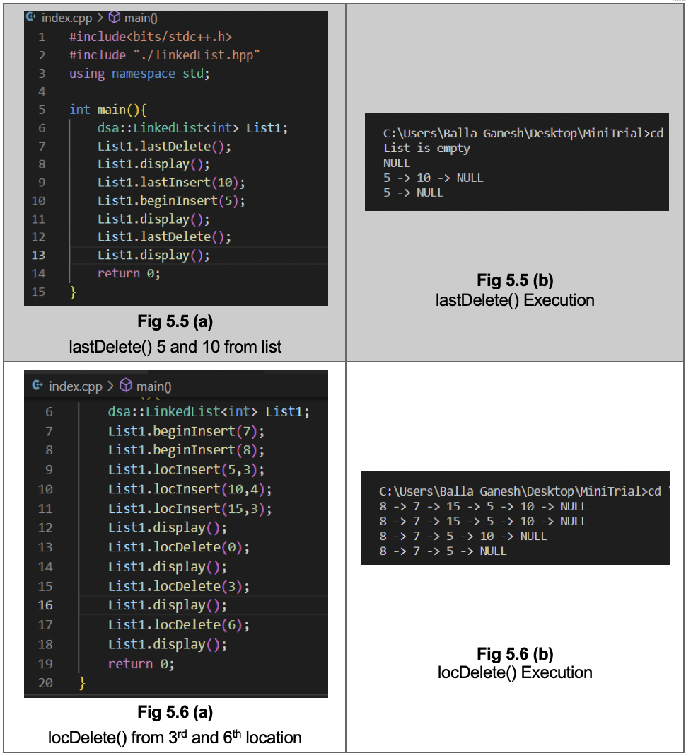

Slide 22
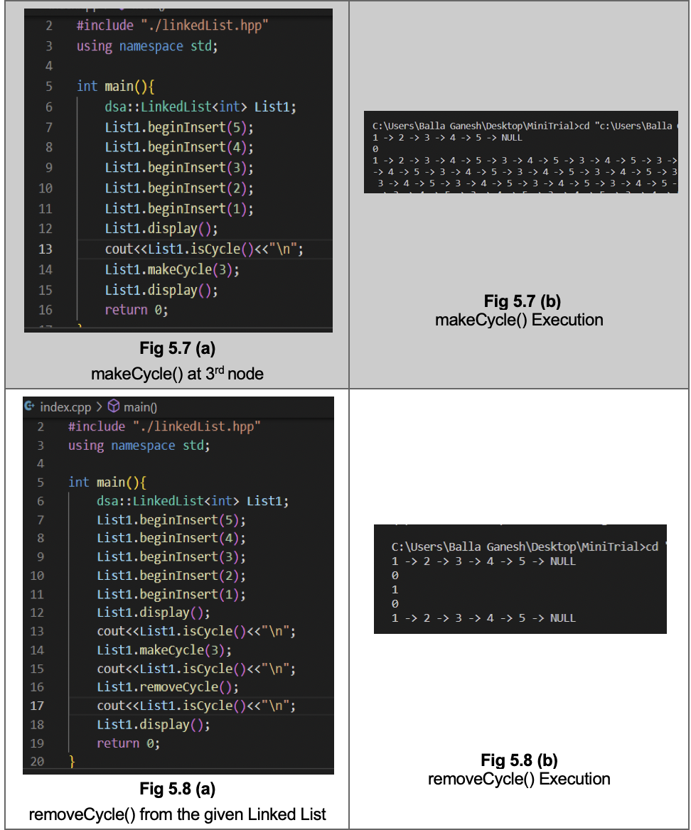

Slide 23
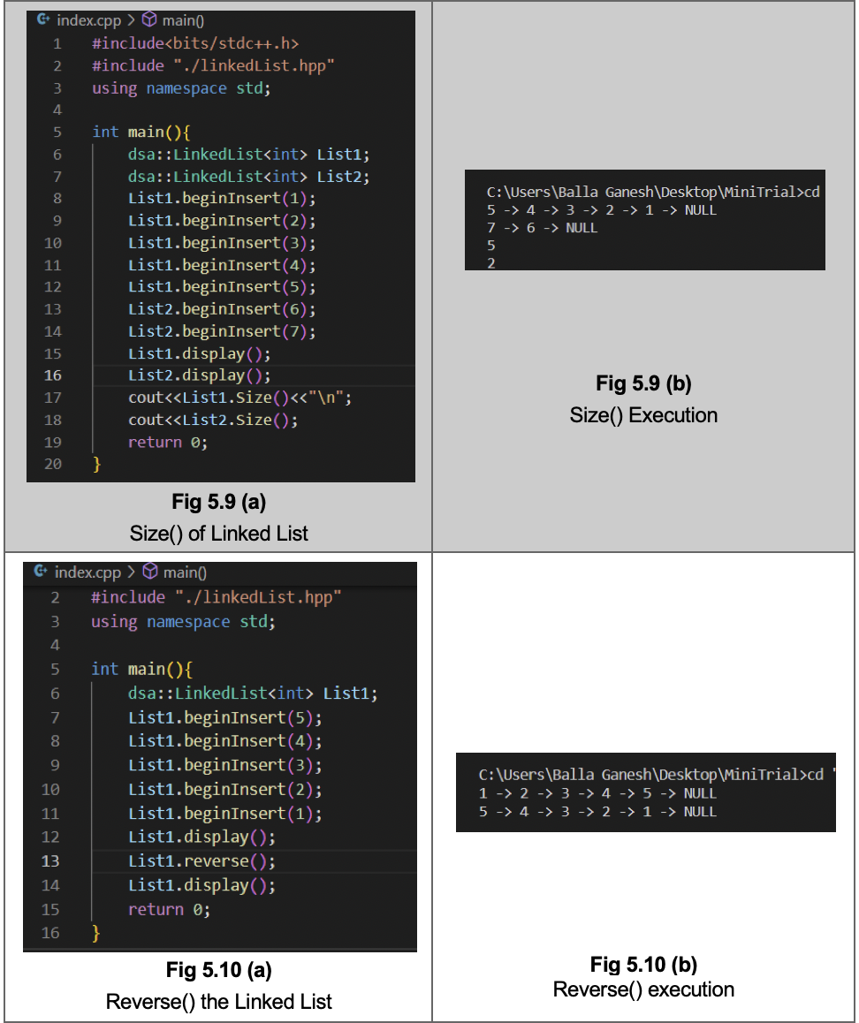

Slide 24
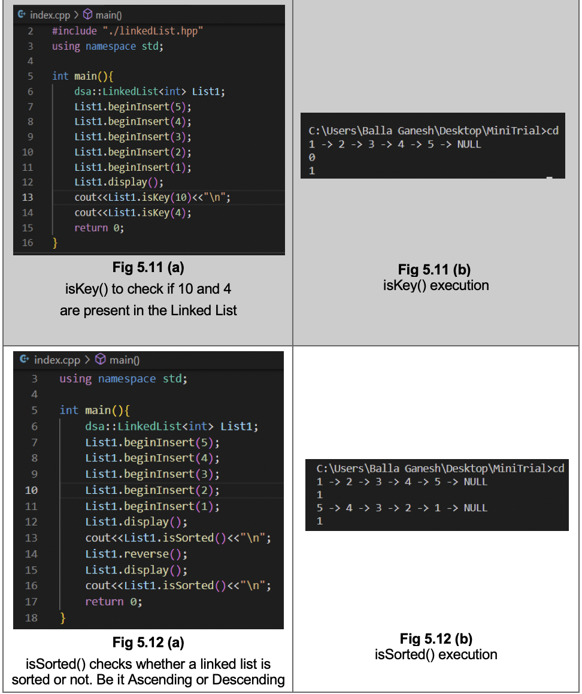

Slide 25
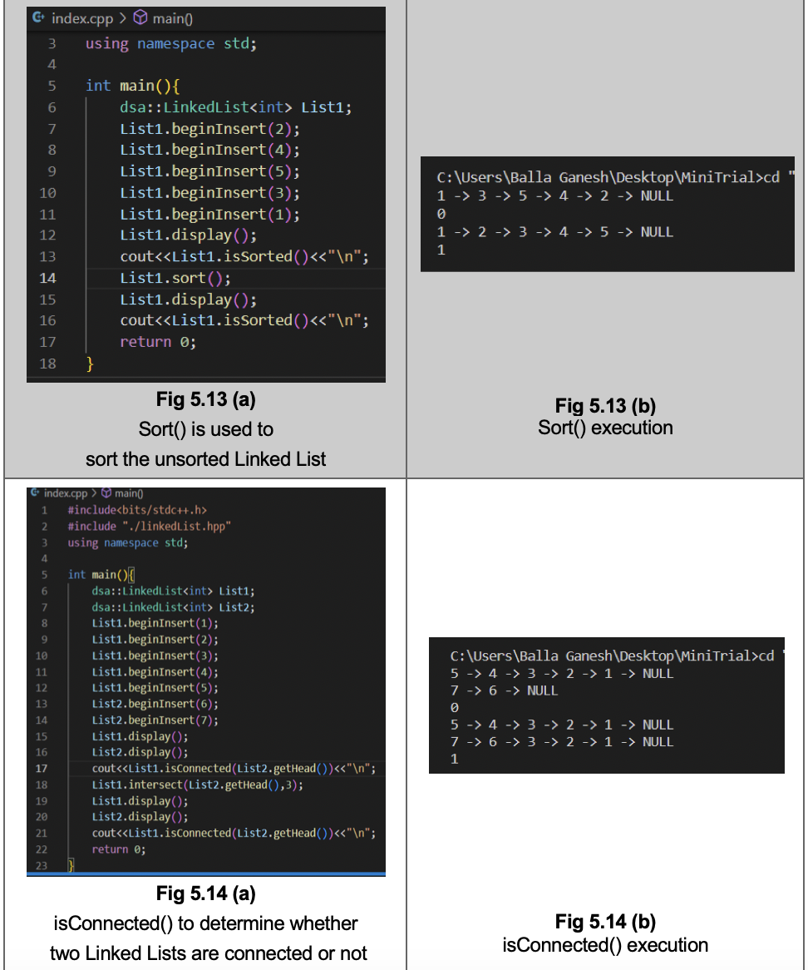

Slide 26
Conclusion
Our project provides a basis to increase the reusability of code and also the help in removing the redundant code. We generally make use of the functions which are declared/defined in the body of code.
But the function’s scope is only local to that particular file. And it cannot be accessed among other files. So, to address this issue we can make use of Header Files.
By making use of Header Files we can globally access the function that are defined in the header file. This therefore increases the code reusability and increase the efficiency by making use of the predefined functions in the applications/problems that are solved by using the Linked Lists concept.

Slide 27
Future work
We primarily focused on Singly Linked Lists in this project as it is frequently used in competitive coding and other aspects. But, we can increase the scope of this project in the future by implementing this concept of custom header files to other types of linked lists i.e. Doubly Linked List and Circular Linked Lists.
We included most of the frequently used functions in the Custom Header File. There are some other functions we can add in the future. For example, there is a possibility to add a merge and sort function to the existing model which we have worked on.

Slide 28
References
https://learn.microsoft.com/en-us/cpp/cpp/header-files-cpp?view=msvc-170
https://gcc.gnu.org/onlinedocs/gcc-12.2.0/libstdc++/manual/

Slide 29
Thank You!

